Slide 1
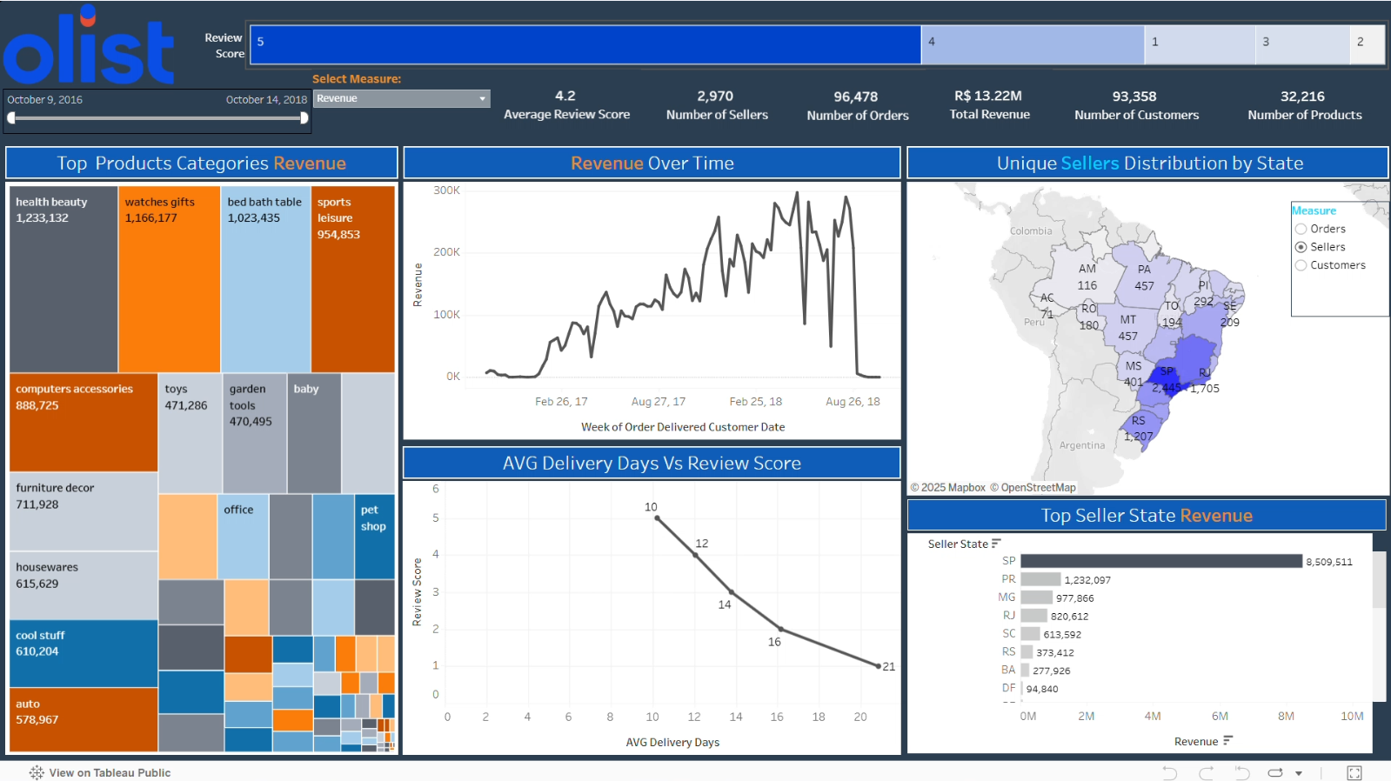
Olist E-Commerce Analysis
By Ahmad Assi
Background
Olist is an e-commerce marketplace that connects businesses with customers. This analysis explores sales trends, top-performing sellers, and delivery performance to optimize business strategies and enhance customer satisfaction.
EDA
Dashboard
Figure 1 :
Orders with longer delivery times tend to receive lower review scores, while faster deliveries are associated with higher ratings.
Data
A public dataset from Kaggle was used, containing information on e-commerce transactions in Brazil. The dataset includes details about orders, customers, sellers, products, payment methods, and delivery performance.
Data curation is applied to clean the data by removing all unuseful data and filling missing values
Figure 3 : SP State dominates seller revenue, generating significantly higher sales compared to other states, indicating a concentration of top-performing sellers in this region.
Figure 4 : 71% of Orders are concentrated only in SP State , which indicates weak sales in other states.
Figure 6 : The Dashboard provides an interactive way to explore key insights, including sales trends, customer distribution, and delivery performance.
Original Data
99,441 order | 9 tables with Different lengths
Curated data
96,478 order | 5 tables with Different lengths
Figure 2 :
64% of Orders are concentrated in only 14% of products Categories, which indicates the concentration of sales on a few popular products.
Conclusion
The analysis highlights a strong concentration of sales in specific states and product categories. Faster deliveries lead to higher customer satisfaction, while delays impact review scores negatively. These insights can help optimize logistics and product strategies.
Tools
In this project, SQL & EXCEL are used to Complete the data curation Exploratory Data Analysis. Then, Tableau is used to develop a dashboard that
Figure 5 : 85% of orders were delivered in less than 20 days, and 15% exceeded this period.

